Slide 1
PRESENTERS
22-48010-2 Md. Alrafi Shompad
22-47520-2 A.S.M Ashikul Islam
22-48006-2 Nazifa Tabassum Tandra
22-48058-2 M.M. Golam Hafiz

Slide 2

Introduction
This presentation covers literature reviews on advanced object detection methods and concludes with a new hypothesis to improve detection performance.

Slide 3
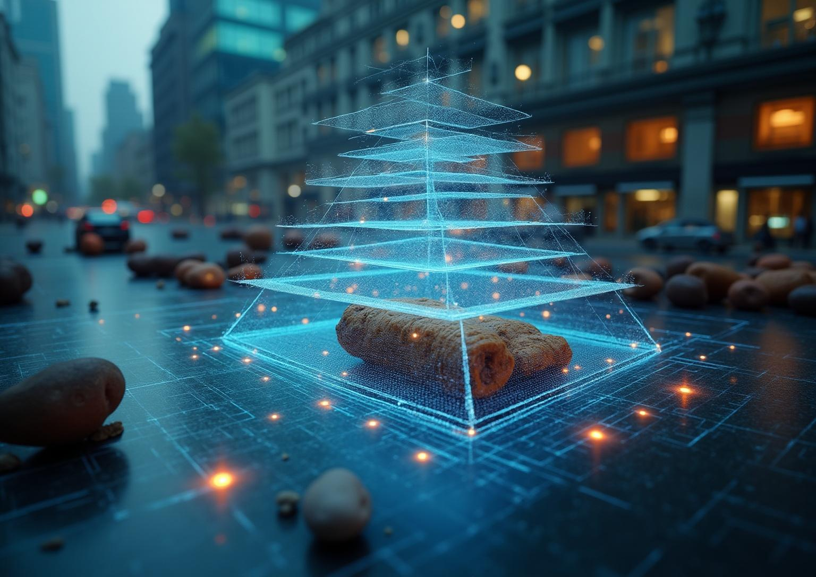
Literature Review of Paper: Feature Pyramid Networks (FPN)

Slide 4
Overview and Challenges in Object Detection
Problem: Detecting objects of different sizes in a single image is difficult.
Challenge: Early layers capture details, deep layers capture meaning—both are needed.
Motivation: Build a fast feature pyramid with both detail and object understanding.
Insight: Merge detailed early maps with semantic deep maps for stronger detection.
Notes:
Problem: Detecting objects of all sizes (e.g., a small mouse and a large bus) in a single image is difficult. Old methods used slow "image pyramids" (resizing the input multiple times).
Challenge: In deep networks, early layers see fine details but don't understand objects, while deep layers understand objects but have lost the fine details needed for small or precise detection.
Motivation: To create a fast, built-in feature pyramid where every level has both fine details and a strong understanding of objects.
Insight: Combine the high-resolution (detailed) maps from early layers with the high-semantic (understanding) maps from deep layers to create a new, powerful pyramid.

Slide 5
Methodology: Bottom-Up and Top-Down Pathways
Bottom-Up: The standard forward pass of a network (like ResNet), which produces feature maps at different scales.
Top-Down with Lateral Connections: This pathway takes the deepest, most "understanding" map and upsamples it (makes it bigger). It then merges it with a corresponding detailed map from the bottom-up pathway. This fusion creates new maps that are both high-resolution and semantically rich.

Slide 6
Data and Training
The model was trained on the standard MS COCO dataset.
The entire system (including FPN) is trained end-to-end, making it efficient and simple.
Objects of different sizes are automatically assigned to the best level of the pyramid for detection.
Notes:
Learn end to end.
Know every topic used inpaper.

Slide 7
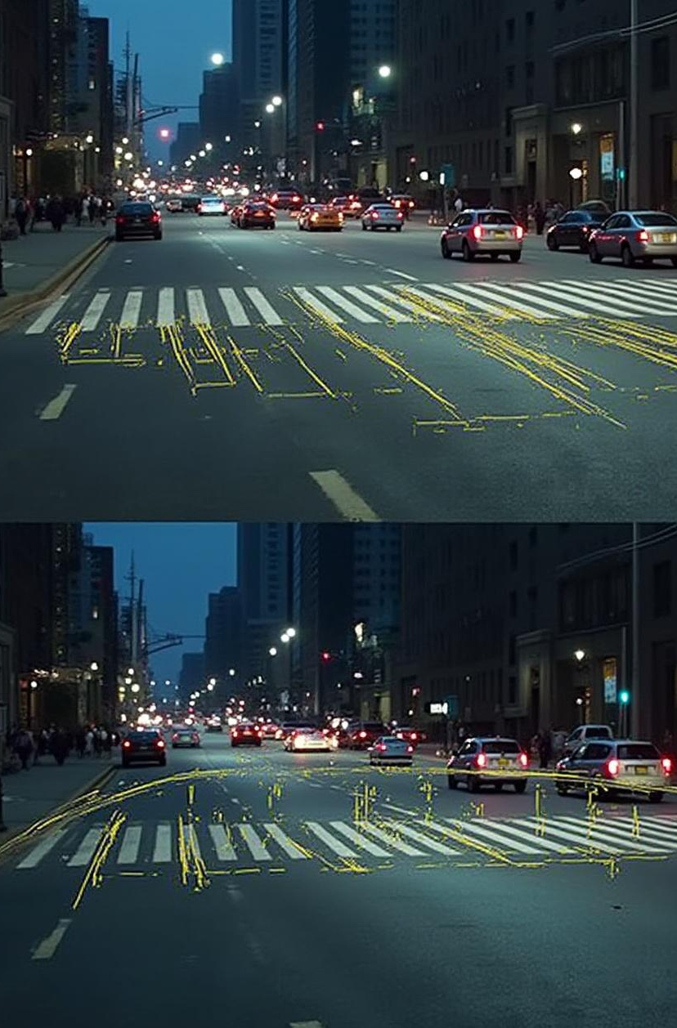
Results and Impact on Small Object Detection
FPN was a breakthrough, delivering:
Massive Gains for Small Objects: A +12.9% improvement in finding small objects compared to R-CNN.
State-of-the-Art Performance: It significantly improved the accuracy of leading detectors like Faster R-CNN.
Efficiency: It ran at 5 FPS, proving it was both powerful and practical for real-world use.
Notes:
What improvement in which work?
V11 best top

Slide 8
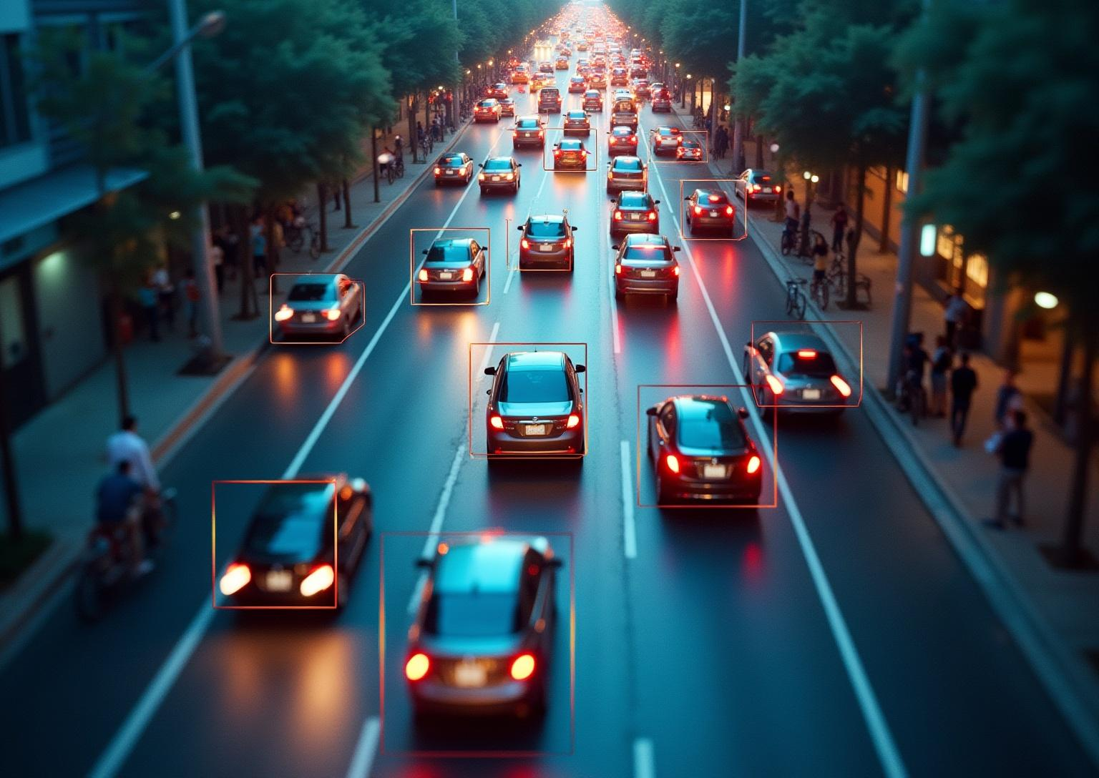
Literature Review of Paper : YOLO (You Only Look Once)

Slide 9
Overview and Motivation
Problem: Early object detectors (like R-CNN) were accurate but too slow and complex for real-time use.
Challenge: How to make detection incredibly fast and simple while still being accurate enough?
Motivation: To create a detector that works like human vision: look at an image once and instantly know what's where.
Insight: Turn object detection from a multi-step process into a single regression problem. Predict all boxes and classes in one step.

Slide 10
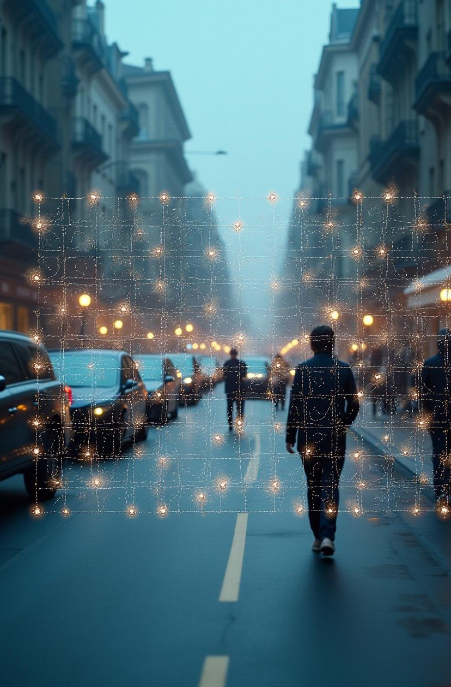
Methodology: Single Neural Network Grid Prediction
It splits the image into a grid (e.g., 7x7).
Each grid cell predicts B bounding boxes and their confidence scores, plus the class probabilities for any object inside it.
A single neural network makes all these predictions at once from the entire image.

Slide 11
Data and Training
The model was first pre-trained on ImageNet for image classification.
It was then trained end-to-end on detection datasets like PASCAL VOC.

Slide 12
Results: Speed and Accuracy Trade-offs
Extremely Fast: It ran at 45 FPS, with a faster version at 155 FPS. This was fast enough for real-time video processing.
Good Accuracy: Its accuracy (63.4% mAP) was lower than the most accurate models but was still good.
Trade-off: It made different errors but was much better at avoiding false positives on background noise. It proved real-time object detection was possible.

Slide 13
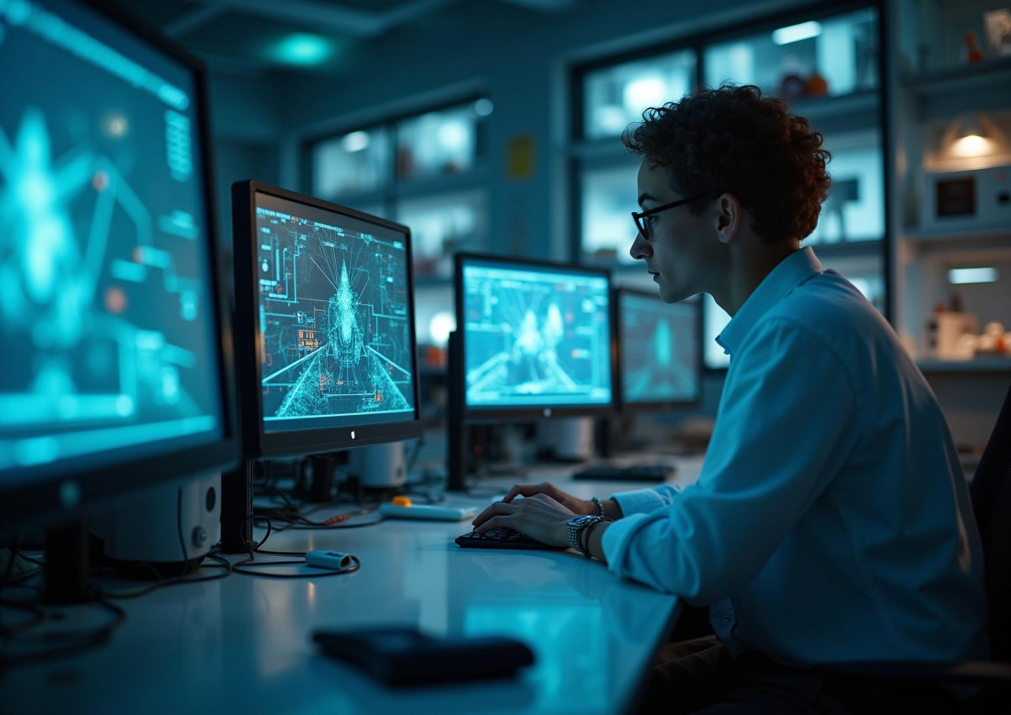
Literature Review YOLO-Z

Slide 14
Overview: Small Object Detection Challenges
Problem: Detecting small, distant objects (like far-away cones) is hard for AI because they lose detail in processing.
Challenge: Improving accuracy usually makes the detector slower, but self-driving cars need real-time speed.
Motivation: Better long-range detection allows autonomous vehicles to make safer decisions earlier.
Insight: The popular YOLOv5 detector can be structurally modified to excel at this specific task without becoming too slow.
Notes:
Small object detection is a major challenge in computer vision. The problem is that tiny or distant objects, like far-away traffic cones, lose critical details during processing, making them hard to detect. The challenge is balancing accuracy with speed—if we make the detector more accurate, it often slows down, which is not acceptable for real-time systems like self-driving cars. The motivation here is clear: better long-range detection means vehicles can make safer decisions earlier. An important insight is that models like YOLOv5 can be structurally modified to handle small object detection more effectively, without sacrificing too much speed.”

Slide 15
Methodology: Architecture Modifications
The authors created YOLO-Z by modifying YOLOv5's architecture:
Backbone: Replaced with DenseNet to better preserve details from the input image.
Neck: Used a simpler FPN to combine features effectively.
Key Change:Replaced the lowest-resolution feature map with a higher-resolution one, giving small objects more pixels to be detected from.
Notes:
In this work, the authors proposed YOLO-Z by making key modifications to YOLOv5’s architecture. First, they replaced the backbone with DenseNet, which helps preserve more details from the input image. Next, they simplified the FPN in the neck, making feature combination more efficient. Finally, the most important change was replacing the lowest-resolution feature map with a higher-resolution one. This ensures that small objects have more pixels to be detected from, improving accuracy without heavily increasing complexity.”

Slide 16
Data and Training
Trained and tested on a custom dataset of ~4,000 images with over 30,000 labelled
cones from a racing car's perspective.
This dataset was perfect for testing as it was full of small objects.

Slide 17
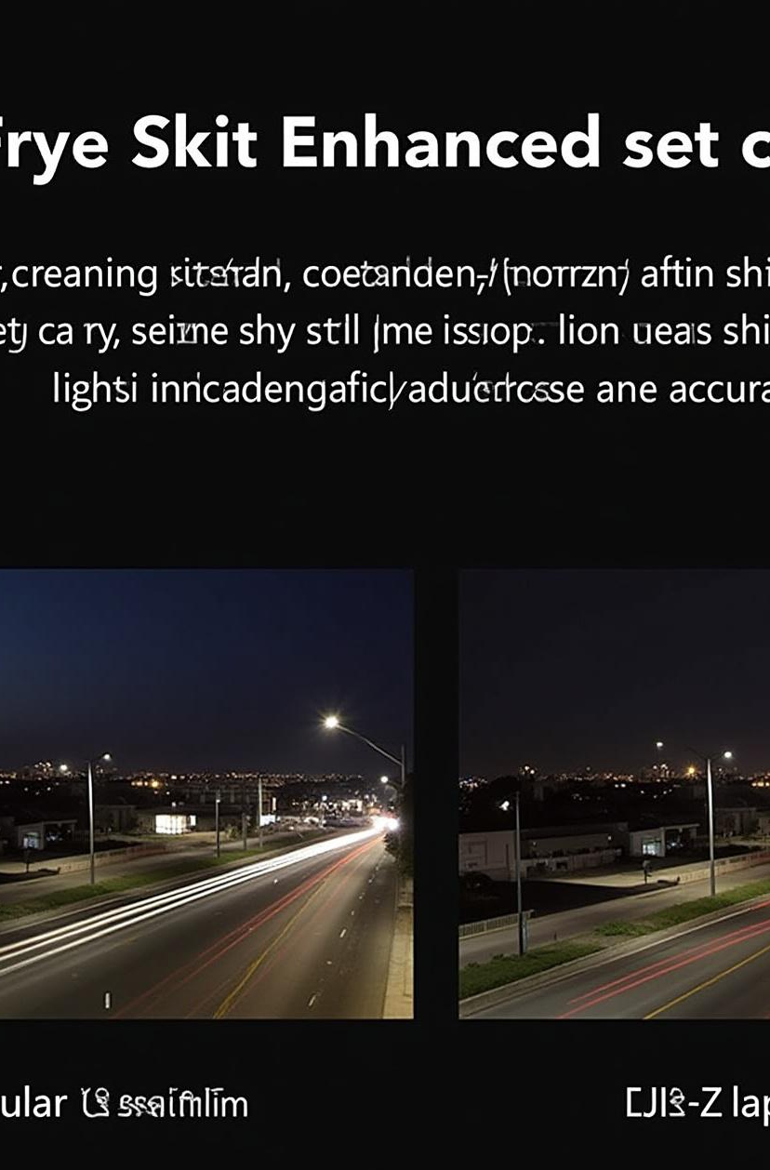
Results: Accuracy Improvements with Minimal Speed Loss
Big Accuracy Jump: YOLO-Z improved detection of small objects by up to 6.9% than YOLOv5.
Minimal Speed Loss: This significant gain only cost an extra ~3 milliseconds in processing time, keeping it real-time.
Conclusion: The changes worked very well, making YOLOv5 much better at seeing small objects without making it slow.
Notes:
The results show a big improvement in detecting small objects. YOLO-Z boosted accuracy by up to 6.9%, which is a significant jump. What’s impressive is that this gain only added about 3 milliseconds of processing time, so the system still runs in real-time. In conclusion, the modifications were highly effective—making YOLOv5 much better at spotting small objects, without slowing it down.”

Slide 18
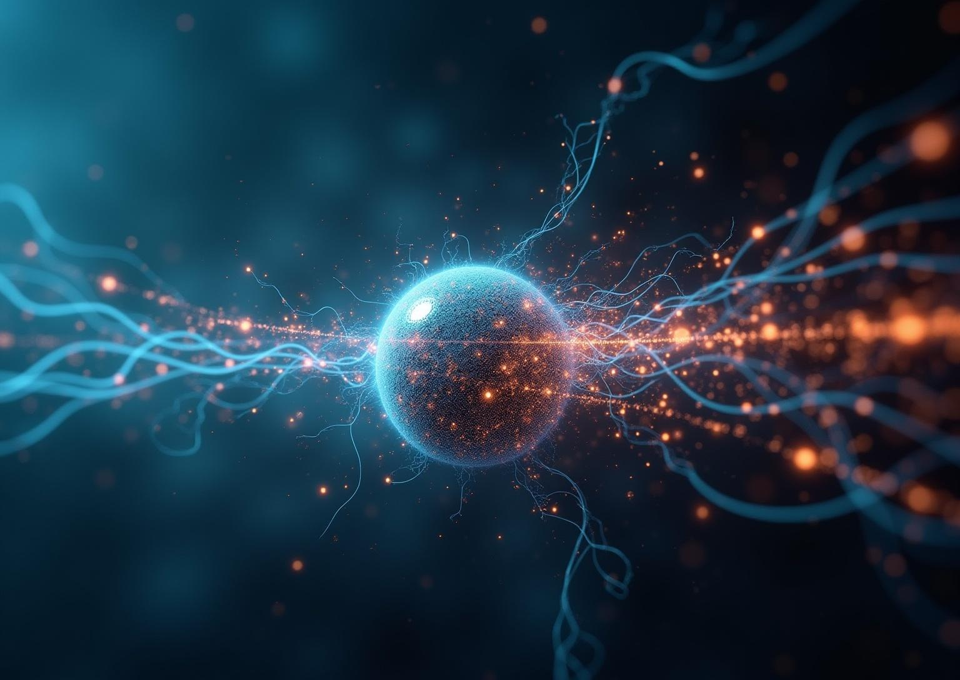
Hypothesis: Adaptive YOLO-Z Pathways

Slide 19
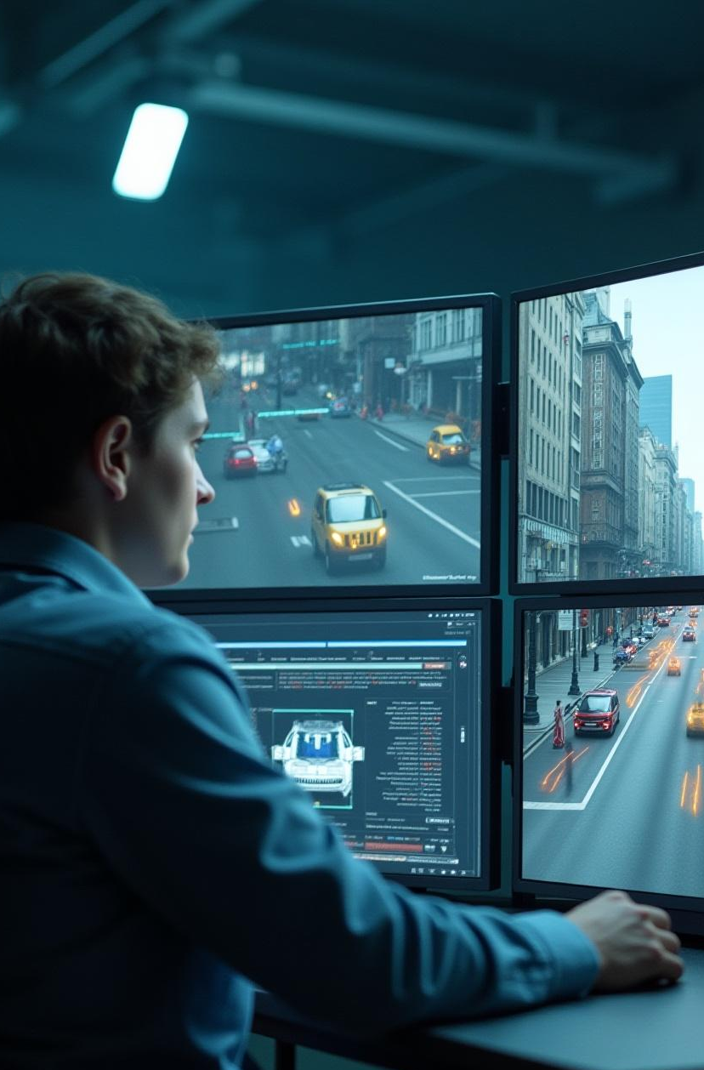
Input Image Scene Analysis
A small, lightweight sub-network first analyzes the input scene.
It quickly estimates the scale of objects present.
Example outputs:
“Scene has many small, distant objects.”
“Scene has mostly large, close-up objects.”
Notes:
So, let’s begin by looking at the first stage of the proposed approach.Here, the idea is that before jumping straight into heavy detection tasks, a *small and lightweight sub-network* takes the lead. You can think of it like a quick scout. Its job isn’t to recognize every single object yet, but rather to get a sense of the *overall scene characteristics*.Now, why is this important? Let me ask you—Have you ever looked at a drone photo from way up in the air and noticed how tiny people and cars look?That’s one scenario. On the other hand, what happens when you look at footage from a shop’s CCTV camera? The faces and vehicles are very large and close-up.This shows that different scenes can have very different object scales. And our system needs to handle both cases intelligently.This initial sub-network essentially makes a quick judgment:* “Am I looking at a scene filled with many small, distant objects?”* Or, “Is this scene dominated by large, close-up objects?”By making this call early, the system avoids wasting computation, while still ensuring accuracy. In other words, it’s like asking the scene a quick question: What kind of image are you giving me? And then preparing the best strategy before diving deeper.

Slide 20
Dynamic Pathway Selection
  Scene with many small objects: It would activate the XS_ex pathway, replacing the low-res map with a high-res one to zoom in on the small details.
  Scene with large objects: It would use the standard YOLOv5 pathway to maintain efficiency and performance on large objects.
  Mixed scene: It could use a weighted combination or a more complex fusion of both feature maps, not just a simple replacement.
Notes:
Now once this early analysis is done, the system moves into what we call *Dynamic Pathway Selection*.Here’s where the adaptation really comes into play.* If the scene has *many small objects, the system activates what’s known as the **XS\_ex pathway*. Think back to that drone image—tiny cars, small people, or distant signs. In this case, the model replaces the low-resolution map with a high-resolution one, zooming in so nothing small gets missed.* If the scene has *larger, closer objects, the system sticks with the **standard YOLOv5 pathway*. Why? Because YOLOv5 already works very efficiently for large, clear objects. Imagine again the CCTV at a shop entrance—no need to overcomplicate the process when the objects are already big enough to see.* And then comes the interesting case: a *mixed scene. Have you ever seen footage from a self-driving car? At the same time, it needs to notice a **pedestrian crossing right in front, which is large, and a **traffic sign far away, which is tiny. In that case, the system doesn’t just pick one pathway blindly. Instead, it may combine both, or even use a more advanced fusion, so that **both the small and the large details are captured*.The key strength here is *flexibility. Instead of forcing one single method for every image, the system intelligently adapts depending on the scene. And that adaptability can greatly **improve detection accuracy* while keeping things efficient.

Slide 21
Thank You
Notes:
* The first stage works like a *scout*, quickly analyzing the image to estimate whether the scene has mostly small or large objects.* The second stage then makes a *dynamic decision*—zooming in with high resolution for small objects, using YOLOv5 for larger ones, or blending both approaches when the scene is mixed.And when you think about real-life applications—drones flying over crowds, CCTV cameras at shops, or self-driving cars on busy roads—this kind of adaptability is not just useful, it’s essential.Because in the real world, scenes are never predictable. And the systems that can adapt on the fly will always perform better than those that cannot.

